Slide 1
Verification and Validation
Unit 6

Slide 2
Outline
Design of Simulation Models,
Verification of Simulation Models,
Calibration and Validation of the models,
Three-Step Approach for Validation of Simulation Models,
Accreditation of Models

Slide 3
Design of Simulation Models
One of the real problems that the simulation analyst faces is to verify and validate the simulation model.
The simulation model is valid only if the model is an accurate representation of the actual system, else it is invalid.
It is the job of the model developer to work closely with the end users (user who have knowledge about the system) throughout the period development and validation.

Slide 4
Design of Simulation Models
Verification and validation is the process of checking that a system meets specifications and that it fulfils its intended purpose.
The distinction between the two terms is largely due to the role of specifications. Validation is the process of checking whether the specification captures the customer’s requirements, while verification is the process of checking that the system meets specifications.

Slide 5
Design of Simulation Models
How to validate and verify model
Verification is the process of comparing two or more results to ensure its accuracy. In this process, we have to compare the model’s implementation and its associated data (computational model) with the developer's conceptual description and specifications.
Validation is the process of comparing two results. In this process, we need to compare the representation of a conceptual model to the real system. If the comparison is true, then it is valid, else invalid.

Slide 6
Design of Simulation Models
Model of a system
A model is a representation of an object, a system, or an idea in some form other than that of the entity itself.
A model is defined as a representation of a system for the purpose of studying the system. It is necessary to consider only those aspects of the system that affect the problem under investigation. These aspects are represented in a model, and by definition it is a simplification of the system.
A model is similar to but simpler than the system it represents.
One purpose of a model is to enable the analyst to predict the effect of changes to the system.

Slide 7
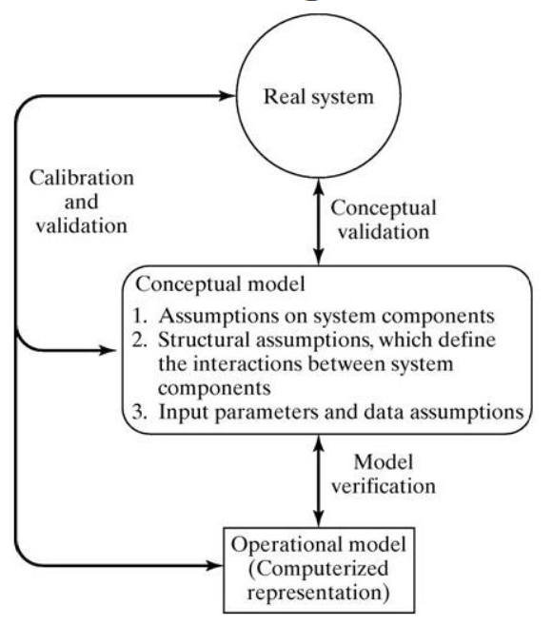
Design of Simulation Models
Model Building:
1) Determine the goals and objectives
2) Build a conceptual model
3) Convert into a specification model
4) Convert into a computational model
5) Verify
6) Validate

Slide 8
Design of Simulation Models
Model Building:
1. The first step in model building consists of observing the real system and the interactions among its various components and collecting data on its behavior.
Operators, technicians, repair and maintenance personnel, engineers, supervisors, and managers understand certain aspects of the system which may be unfamiliar to others.
As model development proceeds, new questions may arise and the model developers will return, to this step of learning true system structure and behavior.

Slide 9
Design of Simulation Models
Model Building:
2.The second step in model building is the construction of a conceptual model – a collection of assumptions on the components and the structure of the system, plus hypotheses on the values of model input parameters, illustrated by the following figure
3.The third step is the translation of the operational model into a computer recognizable form- the computerized model.

Slide 10
Verification of Simulation Models
Verification is the process of determining that a model implementation and its associated data accurately represent the developer's conceptual description and specifications.
Verification answers the question "Have we built the model right?“. It is concerned with building the right model
It is utilized in comparison of the conceptual model to the computer representation that implements that conception. It asks the questions: Is the model implemented correctly in the computer? Are the input parameters and logical structure of the model correctly represented?
Verification is an iterative process aimed at determining whether the product of each step in the development of the simulation model fulfills all the requirements levied on it by the previous step and is internally complete, consistent, and correct enough to support the next phase

Slide 11
Verification of Simulation Models
Techniques to Perform Verification of Simulation Model
By using programming skills to write and debug the program in sub-programs.
By using “Structured Walk-through” policy in which more than one person is to read the program.
By tracing the intermediate results and comparing them with observed outcomes.
By checking the simulation model output using various input combinations.
By comparing final simulation result with analytic results.

Slide 12
Verification of Simulation Models
Techniques to Perform Verification of Simulation Model:-
Have the computerized representation checked by someone other than its developer.
Make a flow diagram which includes each logically possible action a system can take when an event occurs, and follow the model logic for each a for each action for each event type
Closely examine the model output for reasonableness under a variety of settings of input parameters.
Have the computerized representation print the input parameters at the end of the simulation to be sure that these parameter values have not been changed inadvertently.
Make the computerized representation of self-documenting as possible.
If the computerized representation is animated, verify that what is seen in the animation imitates the actual system.
Graphical interfaces are recommended for accomplishing verification & validation .

Slide 13
Calibration and Validation of the models
Validation is the process of determining the degree to which a simulation model and its associated data are an accurate representation of the real world from the perspective of the intended uses of the model.
validation answers the question "Have we built the right model?”. Validation is concerned with building the right model
It is usually achieved through the calibration of the model.

Slide 14
Calibration and Validation of the models
Goal of the validation process
To produce a model that represents true system behavior closely enough for the model to be used as a substitute for the actual system for the purpose of experimenting with system.
To increase an acceptable, level the credibility of the model, so that the model will be used by managers and other decision makers.

Slide 15
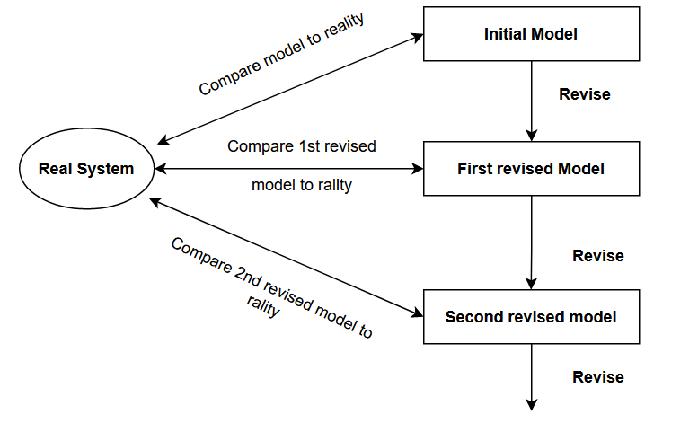
Calibration and Validation of the models
In general, calibration is an iterative process in which the engineer estimates, sets, and adjusts the simulation model parameters until the results produced by the simulator are as accurate as possible for field measurements (real system).
Calibration is the iterative process of comparing the model to the real system, making adjustments to the model, comparing again and so on.

Slide 16
Calibration and Validation of the models
Calibration means to validate the model with the real system, look out for the places for betterment of the models, revise the model to form next better model, repeat the process until a satisfactory model is not achieved
•The figure shows the relationship of the model calibration to the overall validation process.
•The comparison of the model to reality is carried out by variety of test. Test are subjective and objective
Subjective test usually involve people, who are knowledgeable about one or more aspects of the system, making judgments about the model and its output.
Objective tests always require data on the system's behavior plus the corresponding data produced by the model.

Slide 17
Calibration and Validation of the models
Why to calibrate the model ?
Calibration and validation of models are of prime importance to ensure high fidelity and credibility for a simulation model.
Model calibration and validation is important for simulation models to look real.
The findings and conclusions based on the uncalibrated or inappropriately calibrated models could be misleading
Model calibration ensures that the model parameters accurately reflect the local environment so that decisions made based on these results are not misinformed.

Slide 18
Three-Step Approach for Validation of Simulation Models
Build a model that has high face validity:
Build a reasonable model on its face to model users who are knowledgeable about the real system being simulated.
Validate model assumptions:
Structural Assumptions deal with such questions as how the system operates; what kind of model should be used, queuing, inventory, reliability etc.
Data Assumptions deal with what kind of input data model is? What are the parameter values to the input data model, sensitive data?
Compare the model input-output transformations to corresponding input-output transformation for the real system:
Feed input at one end and examine output at other
Use the same input for a real system, compare the output with the model input

Slide 19
Three-Step Approach for Validation of Simulation Models
1. Face Validity
The first goal of the simulation modeller is to construct a model that appears reasonable on its face to model users and others who are knowledgeable about the real system being simulated.
The users of a model should be involved in model construction from its conceptualization to its implementation to ensure that a high degree of realism is built into the model through reasonable assumptions regarding system structure, and reliable data.
The potential users should also be involved in the validation process to aid in identification of model deficiencies and optimize those deficiencies to produce better model.
Sensitivity analysis is also used for face validity of the model. It analyses the effect on output when there is change in input parameters.

Slide 20
Three-Step Approach for Validation of Simulation Models
2. Model Assumptions
Model assumptions fall into two general classes: structural assumptions and data assumptions.
Structural assumptions involve questions of how the system operates and usually involve simplification and abstractions of reality.
For example, consider the customer queuing and service facility in a bank. Customers may form one line, or there may be an individual line for each teller. If there are many lines, customers may be served strictly on a first-come, first-served basis, or some customers may change lines if one is moving faster. The number of tellers may be fixed or variable. These structural assumptions should be verified by actual observation during appropriate time periods together with discussions with managers and tellers regarding bank policies and actual implementation of these policies.
Data assumptions should be based on the collection of reliable data and correct statistical analysis of the data. Data collected example:
Inter arrival times of customers during several 2-hour periods of peak loading ("rush-hour" traffic)
Inter arrival times during a slack period.
Service times for commercial accounts.
Service times for personal accounts.

Slide 21
Three-Step Approach for Validation of Simulation Models
3. Validating Input-Output Transformation
In this phase of validation process the model is viewed as input – output transformation.
The model accepts the values of input parameters and transforms these inputs into output measure of performance.
It involves validating whether the model can predict the behaviour of the real system when the model input data match the real inputs.
Instead of validating the model input-output transformation by predicting the future, the modeler may use past historical data which has been served for validation purposes that is, if one set has been used to develop calibrate the model, its recommended that a separate data test be used as final validation test.
Validation increases modeler’s confidence that the model of existing system is accurate.

Slide 22
Accreditation of Models
The official certification that a model, simulation, or federation of models and simulations and its associated data is acceptable for use for a specific purpose.
Model accreditation is an official determination that a model is acceptable for a specific purpose
Are all the important processes for a given environment included?
Are the processes modeled correctly?
Was the range of data used to develop model components for process simulation wide enough to include our conditions?
Notes:
Simulation models are not 100% accurate

Slide 23
Exercise
Describe the process of model building, verification and validation in brief. [10 marks]
What do you mean by calibration and validation of models.
Why do we use verification and validation in simulation
Explain the three step approach of validation of models in simulation [10 marks]
Explain verification of simulation models with example
Explain the iterative process of calibrating a model
Verification is concerned with building the “model right” and validation is concerned with building the “right model”. Justify it with suitable reasons

